Slide 1

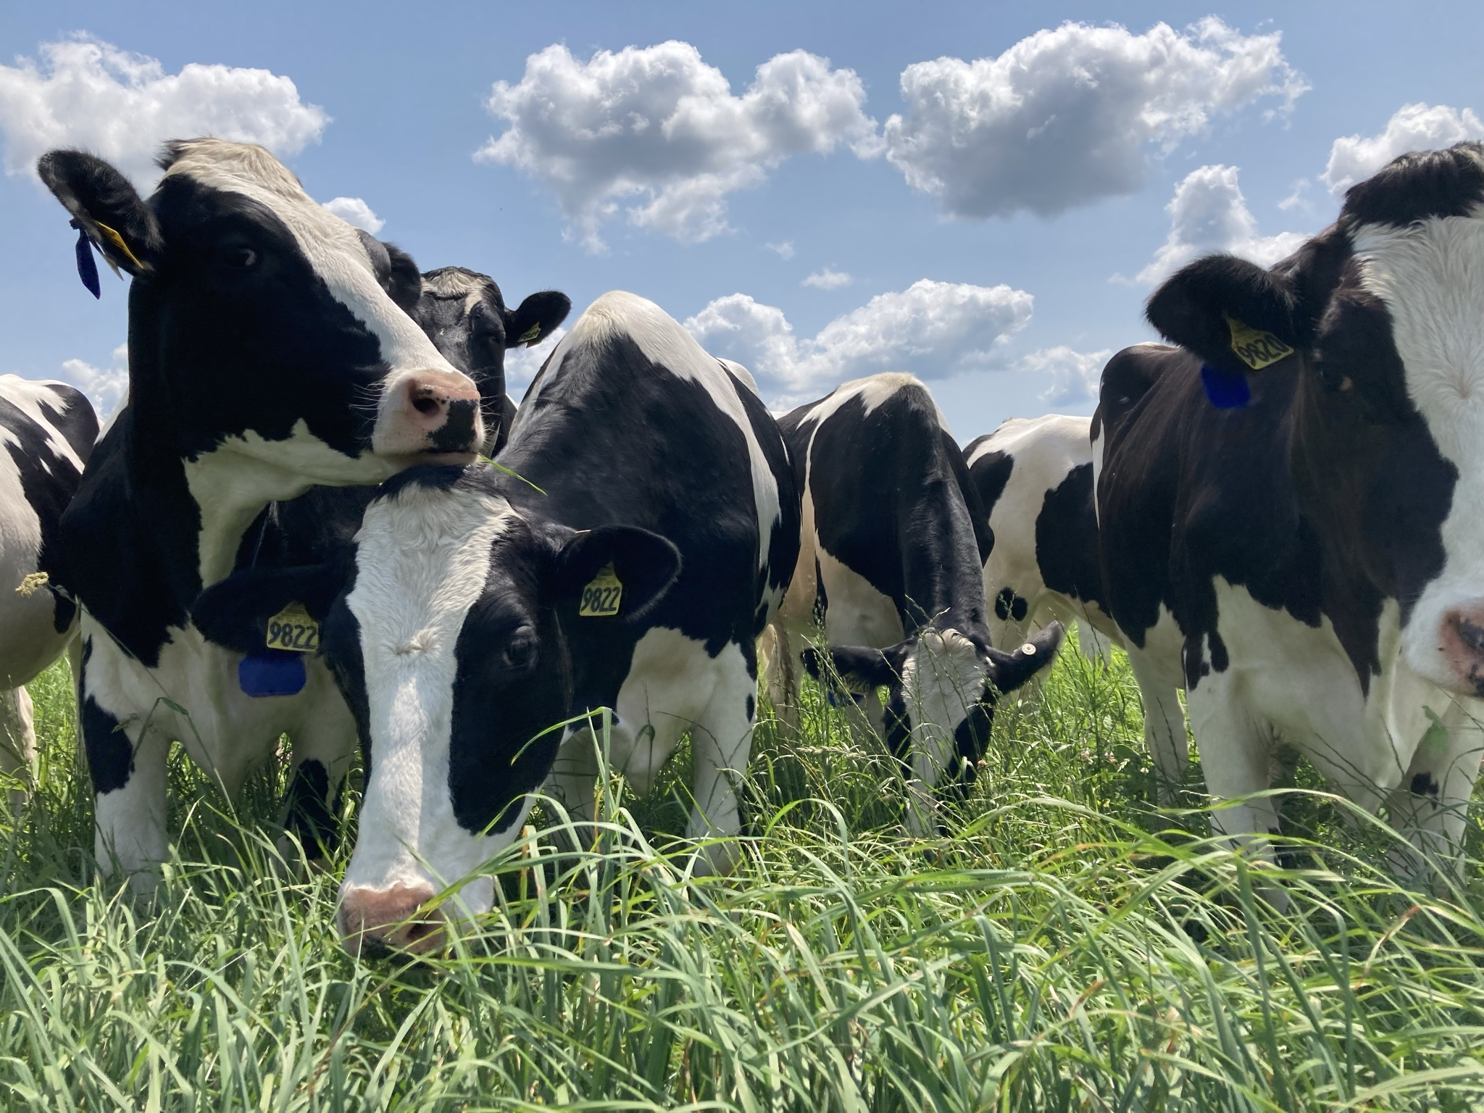


Large Animal and Solar System Operations (LASSO) Prize
Team Name: | UW MARS LASSO
Lead Competitor Name: | Nancy Esser
Submission Title: | Supercharged Pastures: Increasing the sun-capturing capacity of pastures
Number of Cattle: | 28 - 40
Project Location: | 208356 Drake Ave, Stratford, Wisconsin 54484 (Marathon County) USA
Anticipated/Actual Total PV System Capacity that cattle will interact with | 250.56 kWDC, consisting of 464 modules, each rated at 540 watts
Track: | Track 1: Standard Track
Team Members and Partners: Adam Wehling, Arin Crooks, Ashley Blackburn, Bradley Heins, Carthik Thoniparambil, Clement Vijayakumar, Greg Cisweski, Holly Hovanec DVM, Jason Cavadini, Josh Arnold, Michael Maroney DVM, Michael Peters, Patty Laskowski Morren, Paul Daigle, Teri Raatz, Will Cordes, Will Fulwider
System Description: The panel type is a Longi Solar LR5-72HBD-540M (540W). 464 panels will cover a 23,538.68 ft² area. Panels will be a fixed-tilt system, with a 10 ft minimum height at the lowest point and will have an interrow spacing of 18 ft. The tilt angle and orientation is 30° tilt, south-facing (Azimuth 180°). An annual production of 300.5 MWh is estimated to be achieved.

